Slide 1
We create a holiday for you!
Natus Vincere
Organization of Concert

Slide 2
Our posts:
Boss
Financial manager
HR manager
Sales manager
Creative manager
Advertising manager
Natalia Pastukhova
Stas Artemov
Ivan Glazovoi
Katya Simon
Lera Loza
Julia Krasovscaja

Slide 3
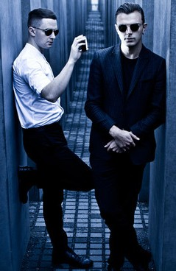
HURTS
Hurts are an English synthpop duo formed in 2009, consisting of singer Theo Hutchcraft and synthesist Adam Anderson. Their first two albums, Happiness and Exile, both reached the top ten in the United Kingdom, Germany, Austria, Switzerland, Poland, and Finland.

Slide 4
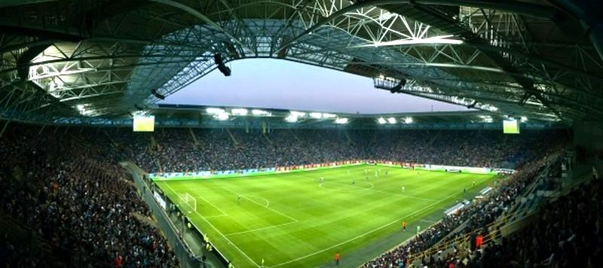
Dnipro-Arena
Dnipro-Arena is a football stadium in Dnipropetrovsk, Ukraine. It is mostly for football matches and hosts the homes matches of FC Dnipro Dnipropetrovsk. The stadium has a capacity of 31,003 people. It replaced Dnipro's old Soviet Metalurh Stadium.

Slide 5
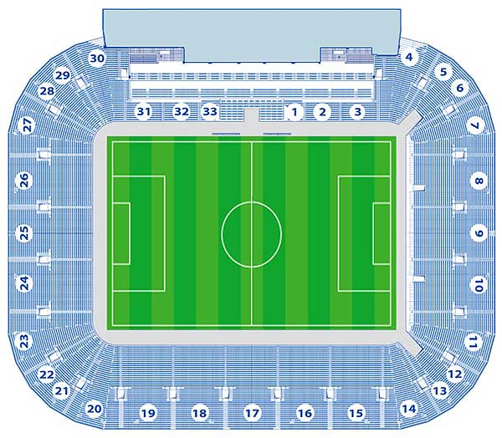
Capacity : 14000 seats+6000 (fan-zones) +120 seats (for VIP)
Total: 20120
Regularly used for
concerts
Convenient
location
Liked by bands
Price: 200 000 UAH
(FC)

Slide 6
Sponsor:
PrivatBank (Ukrainian: ПриватБанк) is the largest commercial bank in Ukraine, in terms of the number of clients, assets value, loan portfolio and taxes paid to the national budget. PrivatBank has its headquarters in Dnipropetrovsk, in central Ukraine.

Slide 7
Marketing (VC)
70 Billboards – 2000 UAH per each a month – 3 months – 10 000 UAH – 420 000 UAH
TV advertising (1+1 channel) –
500 000 UAH
Radio advertising (Hit Fm, Europa plus) – 50 00o UAH
Internet-advertising – 50 000 UAH
Souvenirs
1000 Posters – 5 UAH per each (cost).
Price – 10 UAH
1000 T-shirts – 120 UAH.
Price – 200 UAH.
3000 Badges – 4 UAH.
Price – 8 UAH.

Slide 8
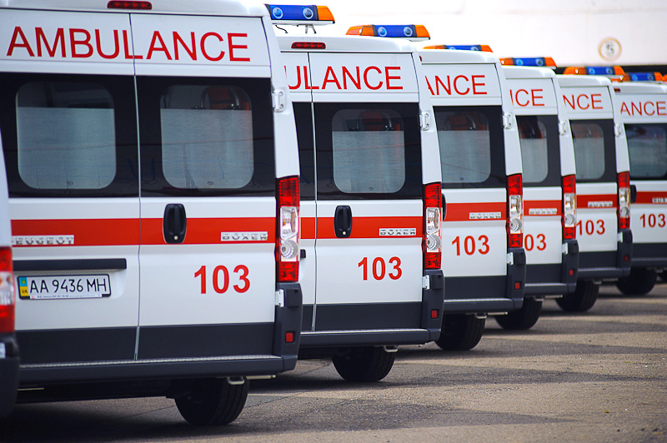
Health and Safety
10 paramedical teams (consist of 6 professionals)
3000 UAH*10 = 30 000 UAH

Slide 9
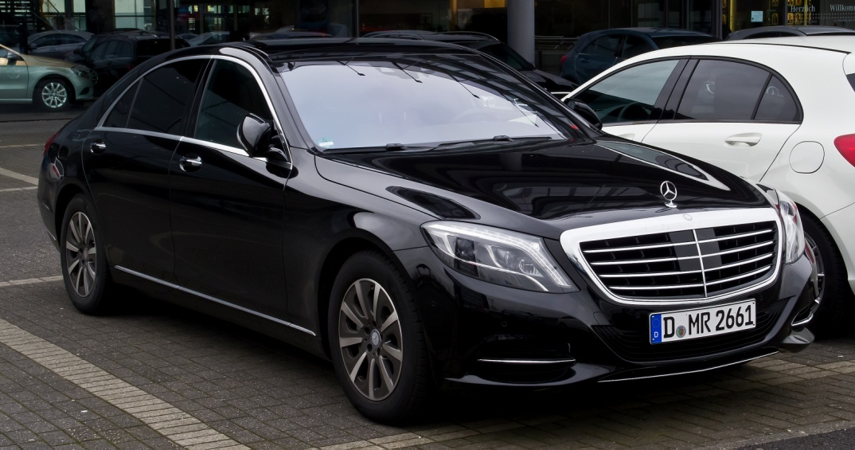
Transport
For Hurts:
Airline tickets
London-Dnepropetrovsk-London:
9 first class seats - 330 229 UAH
10 economy class seats - 173 676 UAH
Rental of Mercedes-Benz car (2 days) – 120 000 UAH Rental of three Mercedes Sprinter minibuses (2 days) - 180 000 UAH
For fans:
Rental of thirteen Mercedes Sprinter minibuses (4 hours)- 39 000 UAH

Slide 10
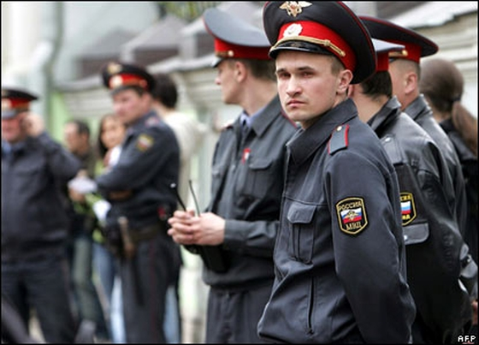
Police and Security
For attendees - 320 UAH/hour for 1 security guard;
1 guard per 100 ticket sold;
20 000 tickets = 20 guards;
5 hour-concert (1 600UAH/guard) =
32 000 UAH
For the band - 170 UAH/hour for 1 security guard;
24 hours = 4080 UAH/guard;
5 guards = 20 400 UAH

Slide 11
Сosts

Slide 12
Costs and profit

Slide 13
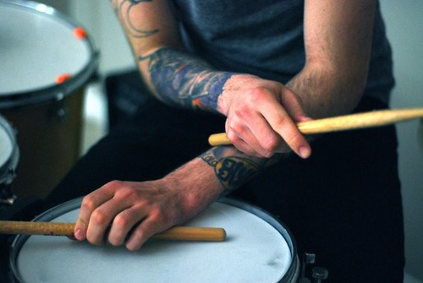
Your bands in our credible hands
Thank you for your attention!

